Slide 1


Migrating Semantic Models to Fabric Direct Lake
Teo Lachev, Prologika
teo.lachev@prologika.com

Slide 2

Agenda
Understanding Fabric memory utilization
Understanding Direct Lake
Migrating from Import to Direct Lake
Performance notes
Download the presentation slides from my blog at https://prologika.com/atlanta-microsoft-bi-group-meeting-202512/

Slide 3

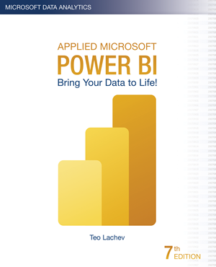

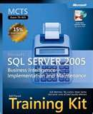
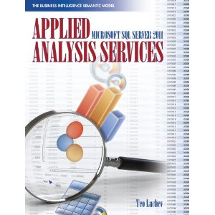


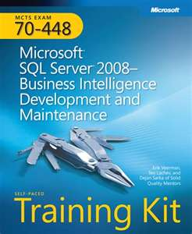
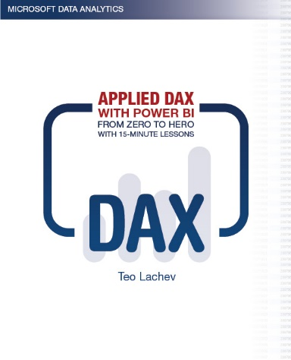
About Teo Lachev
Independent consultant, author, and mentor (https://prologika.com)
Helping clients make sense of data with data integration & analytics
Microsoft FastTrack Recognized Solution Architect for Power Platform
Microsoft Data Platform MVP for 15 years
Founder and leader of Atlanta MS BI and Power BI group since 2010

Slide 4
Understanding Fabric Direct Lake

Slide 5
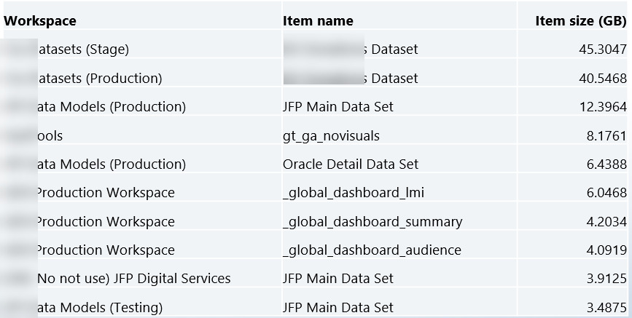
Client Challenge
Large imported semantic models
Constant memory pressure (refresh requires at least twice the memory)
Budget concerns to upgrade from F64->F128->F256
Inability to analyze even larger datasets

Slide 6
Fabric Capacity Limits
SKU | Max memory (GB) | Max Direct Lake model size on OneLake (GB)
F2 | 3 | 10
F4 | 3 | 10
F8 | 3 | 10
F16 | 5 | 20
F32 | 10 | 40
F64 | 25 | Unlimited
F128 | 50 | Unlimited
F256 | 100 | Unlimited
F512 | 200 | Unlimited
F1024 | 400 | Unlimited
F2048 | 400 | Unlimited

Slide 7
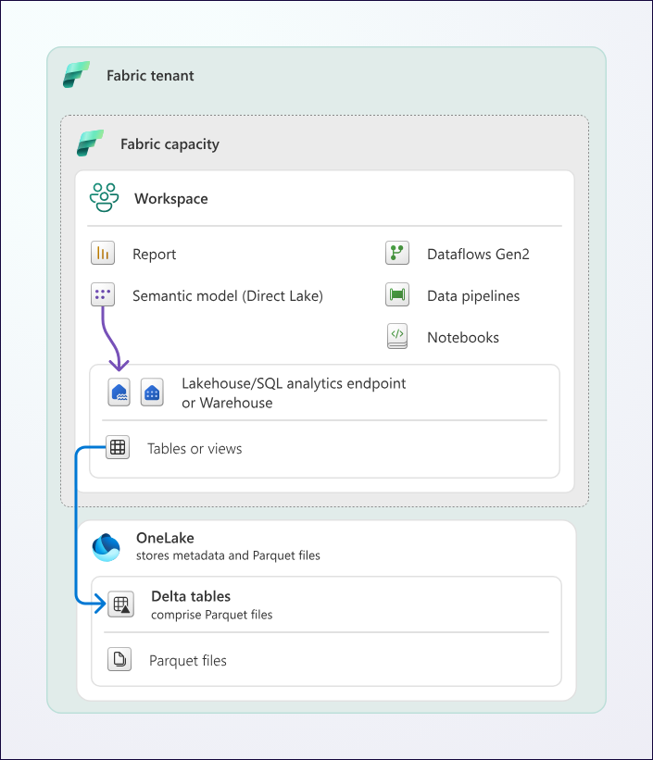
Introducing Direct Lake
Fabric feature (Fabric capacity required)
Requires Delta tables
Fabric Lakehouse
Fabric Warehouse
Shortcuts to delta tables (ADLS, Databricks)
Columns are paged in and out
No refresh required!
Possibility to develop with production-size loads
Two connectivity options to Delta Tables:
(Recommended) Direct Lake on OneLake
(Deprecated) Direct Lake on SQL Endpoint

Slide 8
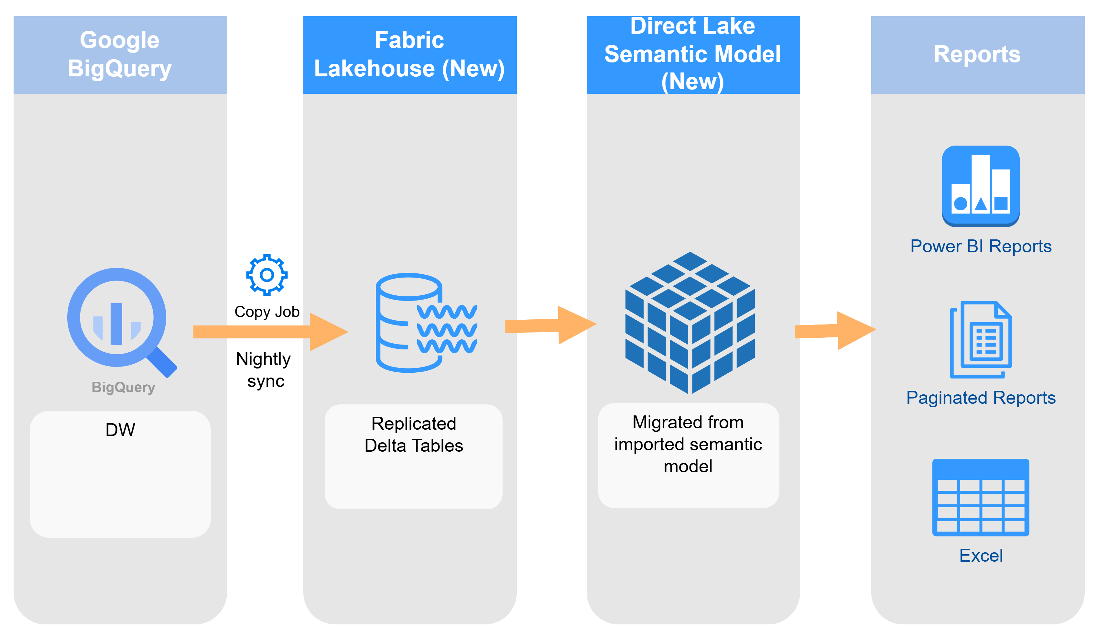
Architecture

Slide 9
Direct Lake Limitations
No Power Query
No views (except Lakehouse materialized views)
Can’t map two model tables to same Delta table (role-playing dimensions) Workaround: clone Delta table
Can’t use dummy tables for measures Workaround: create dummy Delta tables
No calculated tables and columns
Dates must be within 1899-12-30T00:00:00 and 9999-12-31T23:59:59 (otherwise, runtime error)
Schema changes require explicit refresh
Direct Lake is picky! Even a single unresolved source column reference (a field mapped to wrong column in Delta table) will invalidate the entire model.

Slide 10
Migrating to Direct Lake

Slide 11
Semantic Model Migration Steps
Step | Tools
(Project specific) Replicate data from Google BigQuery to Fabric Lakehouse | Copy Job (used) Google Big Query mirroring (considered)
Migrate semantic model from Import to Direct Lake | Microsoft Semantic Link “Migration to Direct Lake” notebook (Project specific) LLM (ChatGPT, Grok, Gemini, etc.) to rebind tables and columns Power BI Desktop and Tabular Editor
Rebind reports | Microsoft Semantic Link “Migration to Direct Lake” notebook to rebind Power BI reports Report Builder to manually rebind paginated reports

Slide 12
Migrate Direct Lake Semantic Model Demo

Slide 13
Replicating Data Testing Fabric Google BigQuery Mirroring
Tested and ruled out Google BigQuery mirroring for security reasons
Relies on BigQuery change history
Requires bigquery.datasets.create and bigquery.jobs.create permissions
Therefore, service account must be added to one of these roles:
BigQuery Admin
BigQuery Data Editor
BigQuery Data Owner
BigQuery Studio Admin
BigQuery User
If these permissions are not overly permissive for you, mirroring might be a good option because it eliminates ETL. It might be especially useful when near real-time synchronization is required.

Slide 14
Replicating Data Using Fabric Copy Job
250 million rows replicated in 30-40 seconds!
Currently one job to replicate all tables in Overwrite mode
Limitations:
No incremental extraction
Can’t mix different load options (Append and Overwrite) so you must split tables in separate jobs
No custom SQL SELECT when copying multiple tables
(Bug) Lost explicit column bindings when making changes
Cannot change the job’s JSON file
The user interface is clunky and it’s difficult to work with
No failure notification mechanism
Workaround: add Copy Job to data pipeline or call it via REST API

Slide 15
Migrating Semantic Model Converting from Import to Direct Lake
Use Microsoft Semantic Link “Migration to Direct Lake” notebook
Create Power BI Desktop project connected to converted Direct Lake model
Warning! Notebook doesn’t migrate field parameters properly (had to add extended properties manually)
extendedProperties": [
{
"type": "json",
"name": "ParameterMetadata",
"value": {
"version": 3,
"kind": 2
}
} ]

Slide 16
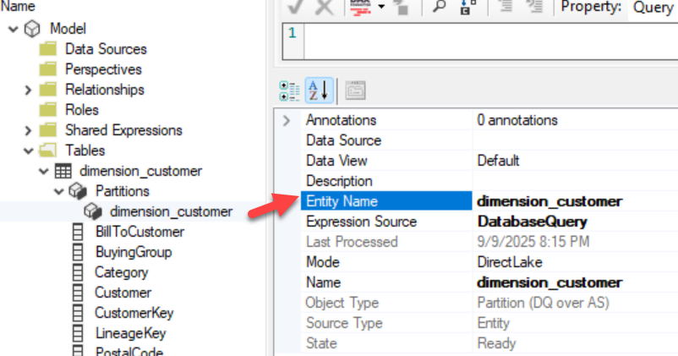
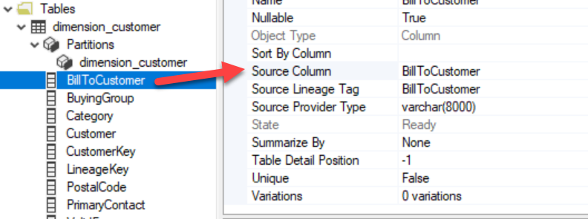
Rebinding Tables and Columns Project-specific step after eliminating Power Query
Used ChatGPT to update table and column bindings
Attached the model *.bim file and Excel metadata mapping file
Asked ChatGPT to update *.bim file
Each table’s Entity Name
Each column’s Source Column

Slide 17
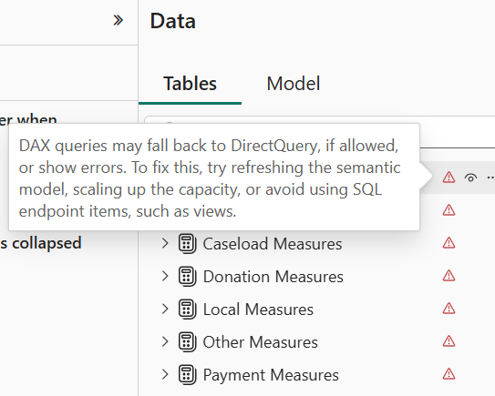
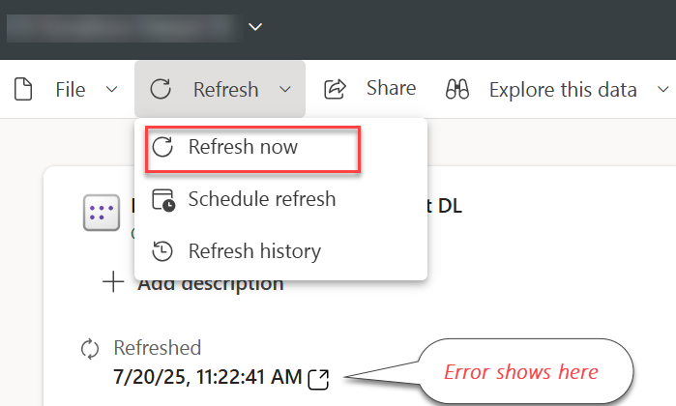
Resolving Mapping Errors Project-specific complication because of rebinding
Power BI Desktop would show error next to each table
To find the actual error:
Go to Power BI Service
In semantic model properties, click Refresh
Hover on error glyph
Fix binding in Tabular Editor and Save
Rinse and repeat for every single error until no errors

Slide 18
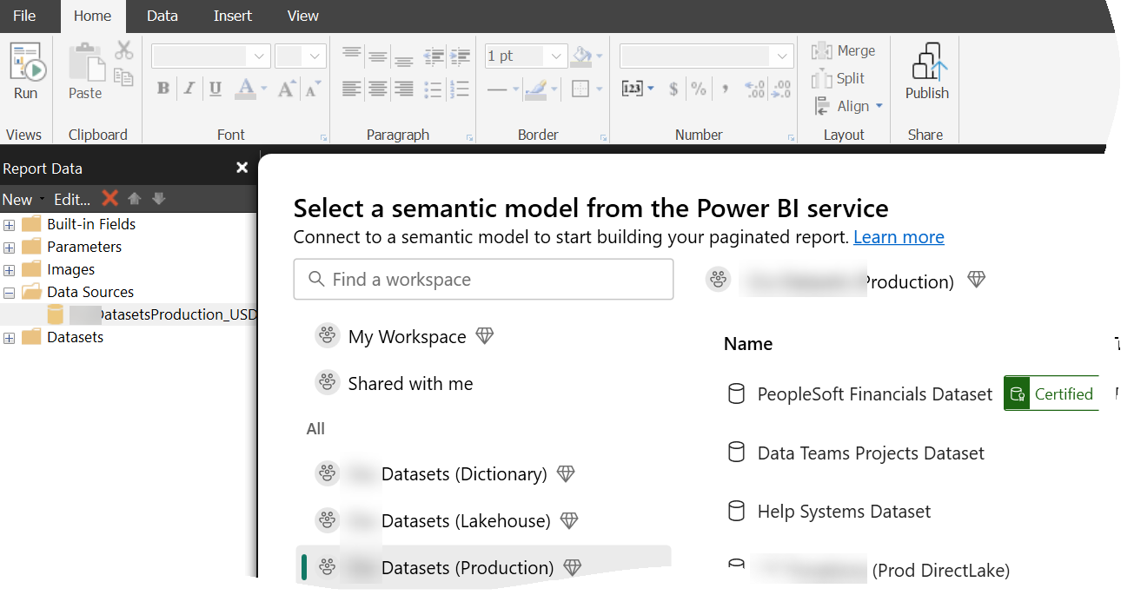
Rebinding Reports
Use Microsoft Semantic Link “Migration to Direct Lake” notebook to rebind Power BI reports
Use Report Builder to manually rebind data source settings for paginated reports

Slide 19
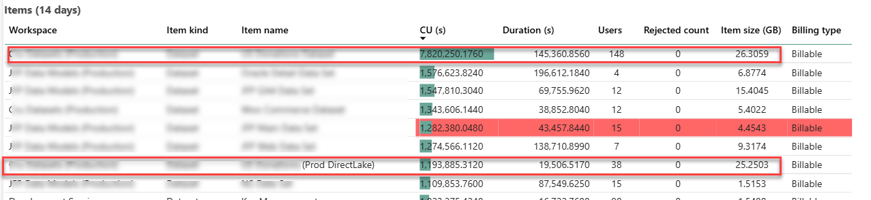
Evaluating Resource Utilization
Memory utilization in line with imported model (minus refresh)
Query performance in line with imported model

Slide 20

Summary
Direct Lake is not substitute for bad design
It eliminates refresh and therefore can help with memory constraints
Migrating from Import to Direct Lake is not that difficult
If you anticipate large datasets, consider Direct Lake from start and store data in Fabric Warehouse or Lakehouse
Need design, implementation, or training help around data integration and analytics?
Email: teo.lachev@prologika.com
Blog: https://prologika.com/blog
Training: https://prologika.com/training
Books: https://prologika.com/books
Notes:
Key Points:
There are a lot of data visualization tools out there, which can create training and management concerns.
Only Microsoft provides the most familiar, and powerful visualization and decision support tools.
Talk Track:
This is the big payoff moment: when you have well managed and curated data people are capable of mixing, matching, visualizing, refining, and ultimately, making the best decisions possible. All of our hard work surfaces here.
My head spins at the sheer volume of data visualization solutions out in the market. Everyone is claiming that they have the latest, best, most advanced data visualization and decision support tools. The problem is that it represents another thing for people to learn—and for you to manage. If the data is not prepared and ready to consume , those shiny tools will not work as advertised.
Microsoft’s secret weapon, well not that secret, is Excel. Over 1 billion people use Excel to make decisions. Over the past years, we have worked hard to build advanced visualization and in-memory capabilities for Excel so that it is the one familiar place everyone can go to visualize and decide.
With Power BI, we’ve overlaid powerful visualization and business intelligence capabilities.
With Q&A, we have the ability to ask simple questions against the prepared data models to return rich charts and graphs. You are not required to retrain people. They are immediately up to speed in Excel and excited about the new ways in which they can interact with data. Since Excel works with Office 365 and SharePoint, you can easily share and appropriately scale ideas—anywhere, on any device.
Imagine all of the ad hoc moments where someone can quickly search, find what they are looking for, and present those insights to a customer or peer?
Most users are not doing BI all day long and are using Microsoft technology to support 90 percent of their daily tasks. With Microsoft, BI is connected to everything you do.
That is the power of Microsoft’s complete data platform. Everything works together to support the self-service capabilities that drive the required data culture necessary to extract as much value from your data investments as possible. Suggestion: clean and analysis ready

